Slide 1
Abstract Classes and
Interfaces

Slide 2
Abstract Classes

Slide 3
Class Shape Hierarchy
Consider the following class hierarchy
Shape
Circle
Square

Slide 4
Problem AND Requirements
Suppose that in order to exploit polymorphism, we specify that 2-D objects must be able to compute their area.
  All 2-D classes must respond to area() message.
How do we ensure that?
  Define area method in class Shape
  Force the subclasses of Shape to respond area() message
Java’s Solutions
  Abstract Classes
  Interfaces

Slide 5
Abstract Classes
Idea
  To define only part of an implementation
    Can contain instance variables & methods that are fully implemented
  Leaving the subclasses to provide the details
Any class with an abstract method must be declared abstract
  However you can declare a class abstract that has no abstract method.
  An abstract method has no implementation (known in C++ as a pure virtual function)

Slide 6
Abstract Classes
If subclass overrides all abstract methods of the superclass, than it becomes a concrete class otherwise we have to declare it as abstract or we can not compile it
Any subclass can override a concrete method inherited from the superclass and declare them abstract
An abstract class cannot be instantiated
However references to an abstract class can be declared
  Can point to the objects of concrete subclasses

Slide 7
Example of abstract class
Shape.java
/* This is an example of abstract class. Note that this class contains an abstract method with no definition.
*/
public abstract class Shape {
public abstract void calculateArea();
}

Slide 8
Circle.java
/* This class extends from abstract Shape class. Therefore to become concrete class it must provides the definition of calculateArea method.
*/
public class Circle extends Shape {
private int x, y;
private int radius;
public Circle() {
x = 5;
y = 5;
radius = 10;
}
// continue

Slide 9
Circle.java
// providing definition of abstract method
public void calculateArea () {
double area = 3.14 * (radius * radius);
System.out.println(“Area: ” + area);
}
}//end of class

Slide 10
Test.java (Driver class)
public class Test {
public static void main (String args[ ]){
//can only create references of abstract class
Shape s = null;
// Shape s1 = new Shape(); //cannot instantiate abstract class
//can point to the concrete subclass
s = new Circle();
s.calculateArea();
}
}

Slide 11
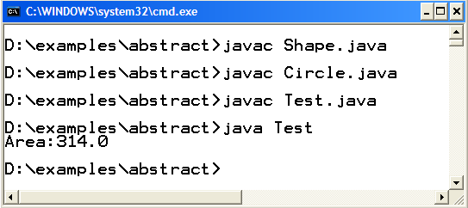
Compile & Execute

Slide 12
Interfaces

Slide 13
Interfaces
  A special java type which
    Defines a set of method prototypes, but does not provide the implementation for the prototypes
    Essentially all the methods inside an interface are Abstract Methods or we can say that an interface is like a pure abstract class (Zero Implementation)
    Can also define static final constants

Slide 14
Interfaces Definition Example
Syntax (appears like abstract class):
All methods are abstract and public by default
All constants are static and final by default
public interface Speaker {
public void speak( );
}

Slide 15
Implementing (Using) Interfaces
Classes Implement interfaces
  Implementing an interface is like signing a contract.
  A class that implements an interface will have to provide the definition of all the methods that are present inside an interface“
  If the class does not provide definitions of all methods, the class would not compile. We have to declare it as an abstract class in order to get it compiled.
“Responds to” relationship
  Relationship between a class and interface

Slide 16
Interface - Example
<<Interface>>
Speaker
speak()
Politician
Coach
Lecturer
speak()
speak()
speak()

Slide 17
Implementing Interfaces Example
class Politician implements Speaker {
public void speak(){
System.out.println(“Talk politics”);
}
}
class Coach implements Speaker {
public void speak(){
System.out.println(“Sports Talks”);
}
}
class Lecturer implements Speaker {
public void speak(){
System.out.println(“Web Desing and Development Talks”);
}
}

Slide 18
Example Code
Defining Interface
public interface Printable {
public void print();
}
Implementing Interface
public class Student implements Printable{
private String name;
private String address;
public String toString () {
return "name:"+name +" address:"+address;
}
// NOT providing implementation of print method
}

Slide 19
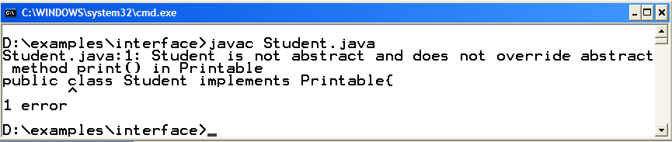
Compile

Slide 20
Example Code (cont.)
Implementing Interface (Modification)
public class Student implements Printable{
private String name;
private String address;
public String toString () {
return "name:"+name +" address:"+address;
}
public void print() {
System.out.println("Name:" +name+" address"+address);
}
}

Slide 21
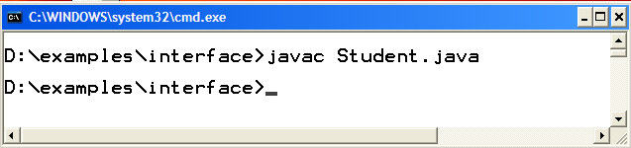
Compile

Slide 22
More on Interfaces
Interface imposes a design structure on any class that uses the interface
Leaves the implementation details to the implementing class and hides that implementation from the client.
A class can implement more than one interfaces. Java’s way of multiple inheritance
class Circle implements Drawable, Printable {
//additional constants and abstract methods
}

Slide 23
More on Interfaces (cont.)
Classes inherit from classes (Single), interfaces inherit from interfaces (Can be multiple) and classes implement interfaces (Can be multiple)
public interface Displayable extends Drawable, Printable {
//additional constants and abstract methods
}
Objects of interfaces cannot be instantiated.
Speaker sp = new Speaker(); // not comaile
However a reference of interface can be created to point to any of its implementation class (Interface based polymorphism).

Slide 24
Interface based Polymorphism

Slide 25
Review again – Interface Example
<<Interface>>
Speaker
speak()
Politician
Coach
Lecturer
speak()
speak()
speak()

Slide 26
Example: Interface based Polymorphism
/* Speaker interface is implemented by the Politician, Coach and Lecturer class. */
public class Test{
public static void main (String args[ ]) {
Speaker sp = null;
System.out.println("sp pointing to Politician");
sp = new Politician();
sp.speak();
System.out.println("sp pointing to Coach");
sp = new Coach();
sp.speak();
System.out.println("sp pointing to Lecturer");
sp = new Lecturer();
sp.speak();
}
}

Slide 27
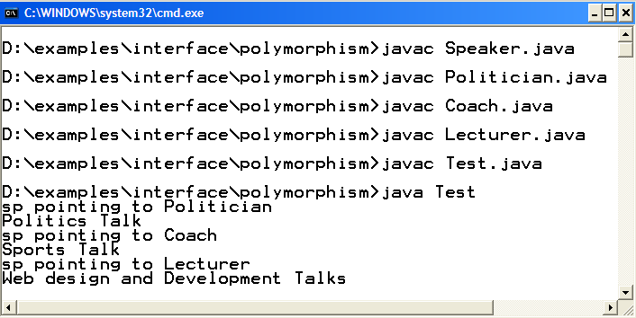
Interface based Polymorphism
Compile & Execute

Slide 28
Interfaces vs. Abstract classes
Fairly similar uses
  designed to group behavior, allow upcasting, exploit polymorphism
Rules of thumb
  Choose abstract class if we have shared code and logical “is a” relationship
  Choose interface if only want to ensure design structure (method signatures) and/or it is not logical to use “is a “ relationship.

